Slide 1
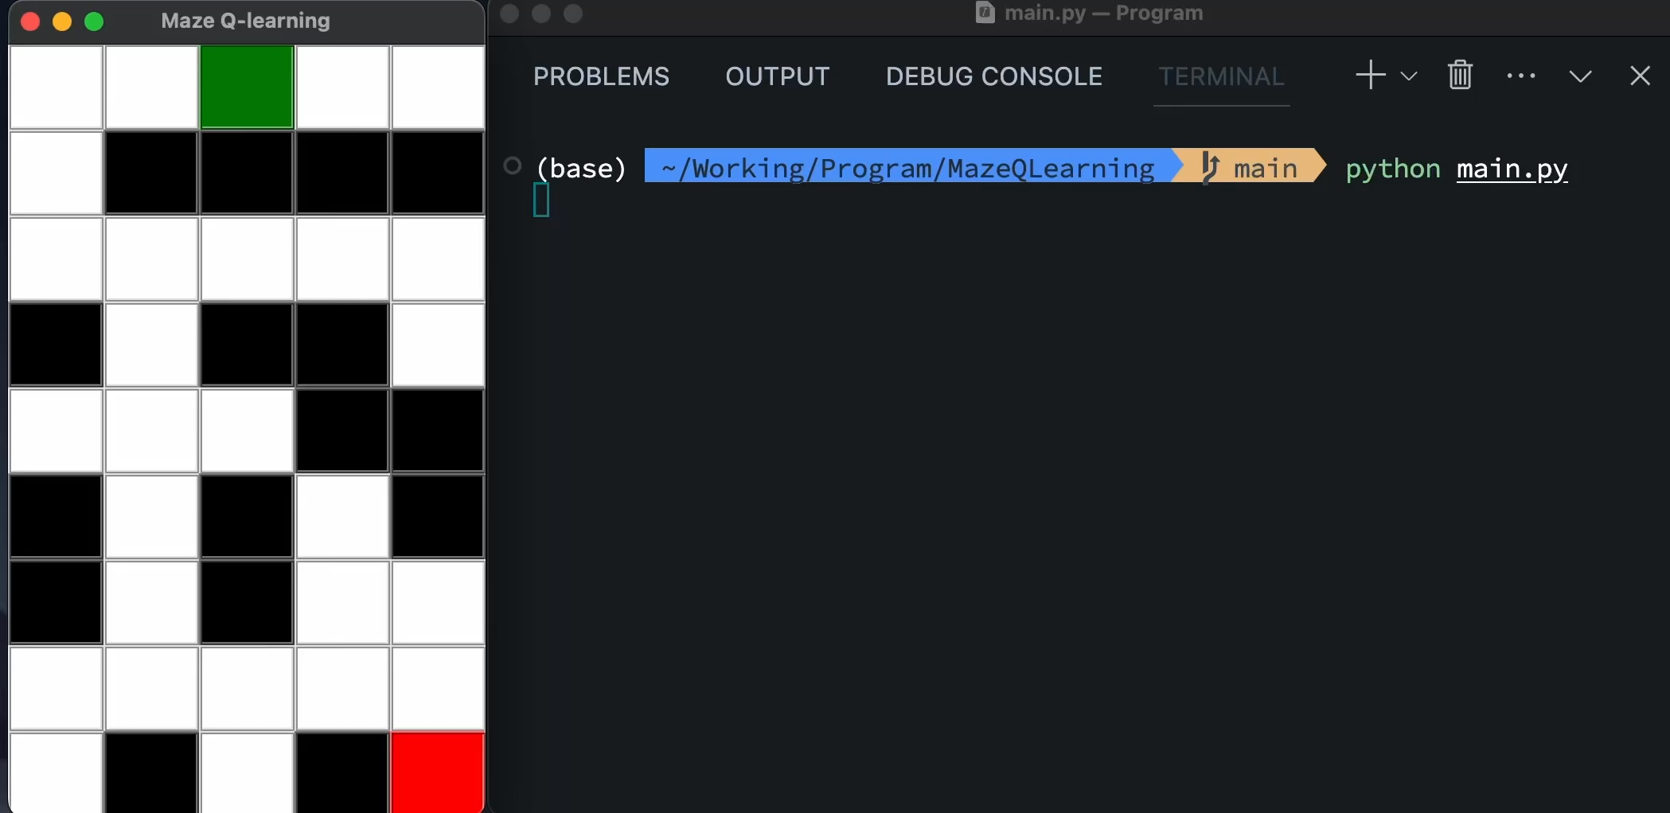
Use Q-Learning to Solve the Maze Path: DEMO
___________________________________________________________________________________________
■：origin
■：road
■：wall
■：goal
Github: https://github.com/ronload/MazeQLearning

Slide 2
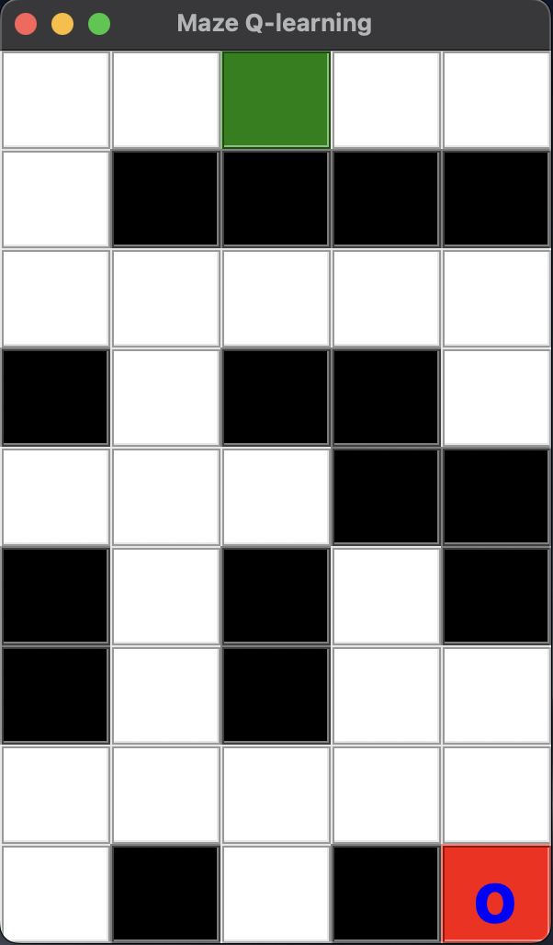
Use Q-Learning to Solve the Maze Path: Maze
___________________________________________________________________________________________
Source Code
Visualizetion
_____________________________
_________________
maze: np.array = np.array([
[0, 0, -1, 0, 0],
[0, 1, 1, 1, 1],
[0, 0, 0, 0, 0],
[1, 0, 1, 1, 0],
[0, 0, 0, 1, 1],
[1, 0, 1, 0, 1],
[1, 0, 1, 0, 0],
[0, 0, 0, 0, 0],
[0, 1, 0, 1, 2]
])
tkinter
* -1 is orgin, 0 is road, 1 is wall, 2 is goal

Slide 3
Use Q-Learning to Solve the Maze Path: Environment.doAction()
___________________________________________________________________________________________
No Move
(nextState == state)
reward = -10
(state, action, nextState)
Reach Goal
(maze[row, col] == 2)
reward = 100
Moving Forward
(else)
reward = -1
* Use current state, action and next state to dicide the reward, and update reward to the Q-table.

Slide 4
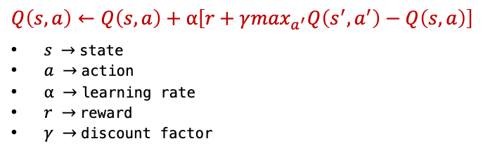
Use Q-Learning to Solve the Maze Path: Agent.QTable、Agent.getAction()
___________________________________________________________________________________________
Q-Table
Choose Action
_________________________________________________
_______________________________________
Current State: (row, col) | Q-Value: [up, down, left, right]
(0, 0) (0, 1) ... ... ... (8, 3) (8, 4) | [-7.000, 24.519, 1.580, 9.919] [ 4.172, 3.732, 21.067, -6.612] ... ... ... [ 0.000, 0.000, 0.000, 0.000] [ 0.000, 0.000, 0.000, 0.000]
Setting a eGreedy variable..
.Generate a random number N (0~1)
* On initialize we set the Q-value to 0.
N > eGreedy
N <= eGreedy
Update Q-Table
_________________________________________________
$$Q\left(s,a\right)←Q\left(s,a\right)+⍺\left[r+γ\max_{a^{′}}Q\left({s^{′},a}^{′}\right)−Q\left(s, a\right)\right]$$
$s →$state
$a →$action
$\text{⍺} →$learning rate
$r →$reward
$\text{γ} →$discount factor
Random Action
Best Action
(which has max Q-value)
* Using epsilon-greedy strategy.

Slide 5
Use Q-Learning to Solve the Maze Path: main
___________________________________________________________________________________________
Initialize
Reach goal
Agent.getAction()
(choose action)
nextState != goal
Agent.doAction()
(calculate reward)
Agent.updateQTable()
Agent.state = nextState
(update state)
nextState == goal
Q Learning Process

Slide 6
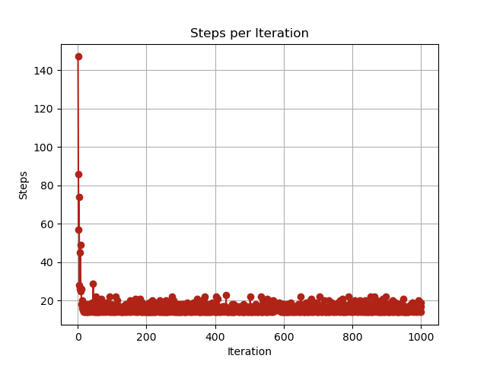
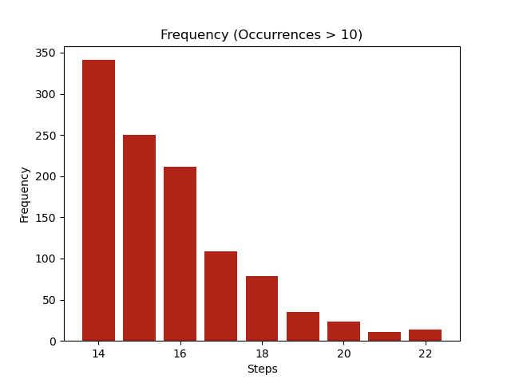
Use Q-Learning to Solve the Maze Path: Result After 1000 Iterations
___________________________________________________________________________________________

